Slide 1
Model Selection & Cross-Validation for
Marijuana Arrest Data

Slide 2
Hello!
Computing and Graphics in Applied Statistics
Anna Atkuru, Rachel Altschuler,
Alexandra Jacko, Celine LaBelle

Slide 3
1.
Abstract
Brief overview of the project

Slide 4
Abstract
As the topic of marijuana use continues to gain attention on a global scale, the ramifications of such use inevitably gains both social and scientific importance. The consequences of criminal arrest due to marijuana possession, particularly whether or not the arrestee was released with a summons, is discussed in the following presentation. To see which variables in our dataset predicted our outcome best, logistic forward, backward, and bi-directional model selection as well as cross-validation measures were implemented with the use of R programming. From strictly looking at the three models, it was difficult to determine which independent variables best predicted the dependent variable since all results were equal. However, through cross-validation analysis, three variables of checks, employed, and citizen was shown to be most effective due to accuracy value. For supplementary reference, we also performed an ROC curve and confusion matrix to further analyze the predictive ability of our model.

Slide 5
2.
Introduction
Dataset Overview - Social Importance - Scientific Relevance

Slide 6
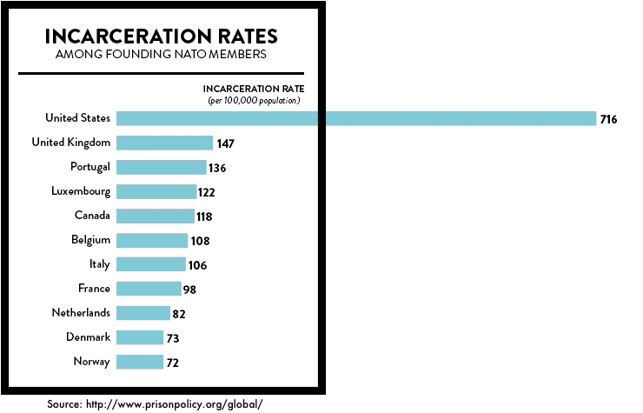
How do the United States’ incarceration rates compare to other nations?
716
The U.S. has the LARGEST prison population on the planet. Internal conflict is usually the best predictor of high incarceration rates in a country. Thus, as a politically stable country without recent civil wars, it is particularly shocking that America tops the incarceration list.
Sources: Kelly, M. (2019, June 26). How many people are in prison on marijuana charges?. The Washington Post. Retrieved April, 10, 2020, from https://www.washingtonpost.com/politics/2019/live-updates/general-election/fact-checking-the-first-democratic-debate/how-many-people-are-in-prison-on-marijuana-charges/?arc404=true
Wagner, P., Sakala, L., & Begley, J. (n.d.). States of Incarceration: The Global Context. Prison Policy Initiative. Retrieved April 10, 2020 from https://www.prisonpolicy.org/global/

Slide 7
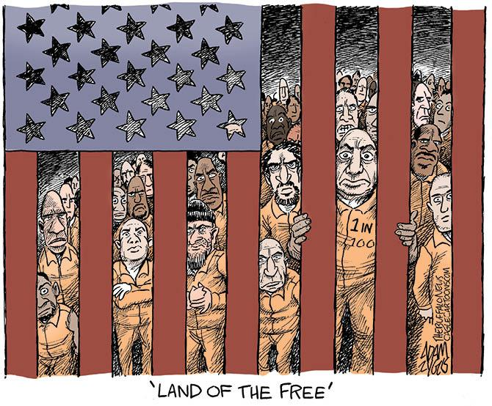
How do rates in NJ and NY compare to other nations?
New Jersey and New York’s rates of incarceration are 506 and 492 out of every 100,000 population, respectively. These rates are similar to those of Cuba’s, and both NJ and NY have higher rates of incarceration than Rwanda and the Russian Federation.
Source: Wagner, P., Sakala, L., & Begley, J. (n.d.). States of Incarceration: The Global Context. Prison Policy Initiative. Retrieved April 10, 2020 from https://www.prisonpolicy.org/global/

Slide 8
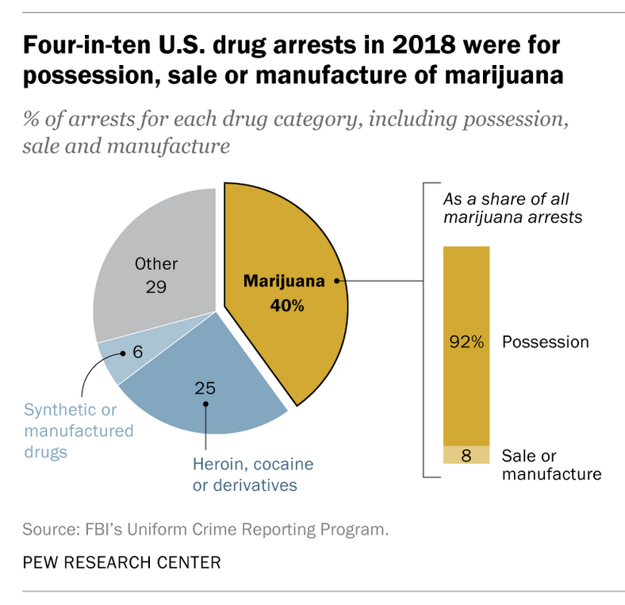
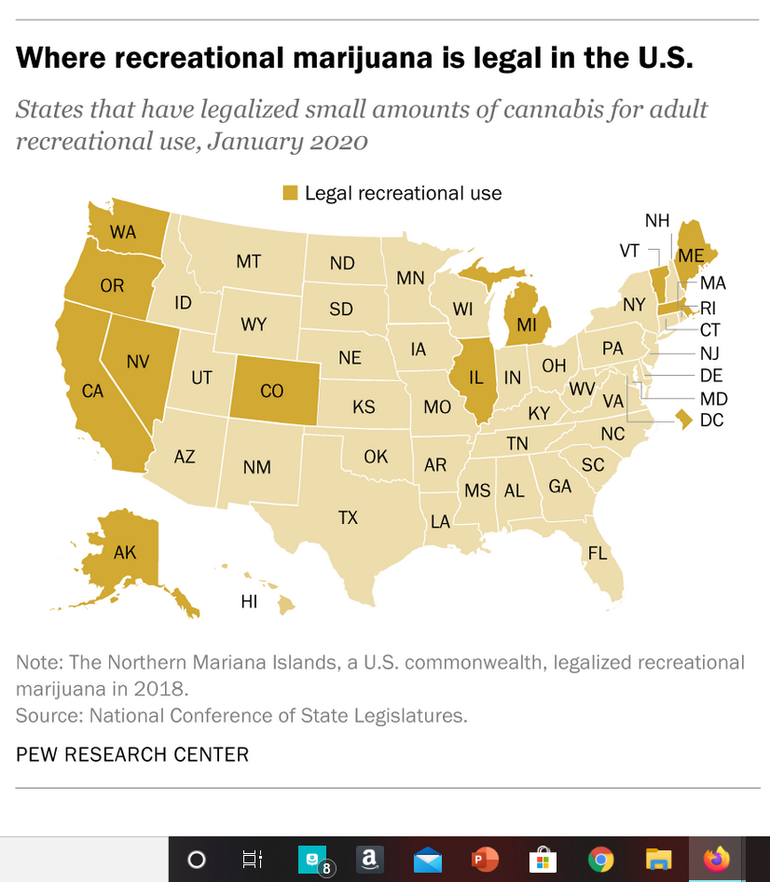
Marijuana Legalization + Drug Arrests, Nationally
Source: Gramlich, J. (2020). Four-in-ten U.S. drug arrests in 2018 were for marijuana offenses - mostly possession. Pew Research Center. Retrieved March 31, 2020, from https://www.pewresearch.org/fact-tank/2020/01/22/four-in-ten-u-s-drug-arrests-in-2018-were-for-marijuana-offenses-mostly-possession/
Notes:
In the U.S., a large portion of drug arrests are due to marijuana.
Note that New Jersey has not yet legalized or decriminalized marijuana.

Slide 9
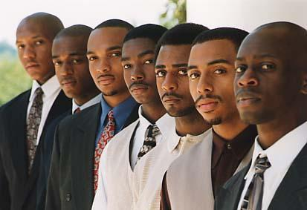
Even worse, drug arrests disproportionately affect people of color :
Despite making up just 31.5% of the U.S. population, the percentage of Black or Latino people arrested for drug law violations is 46.9%.
Source: Drug Policy Alliance. (n.d.). Drug War Statistics. Retrieved April 10, 2020 from https://www.drugpolicy.org/issues/drug-war-statistics

Slide 10
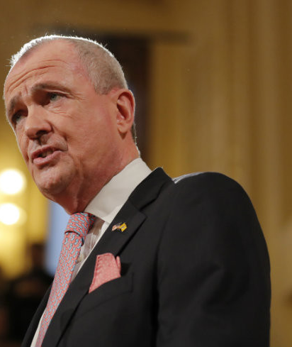
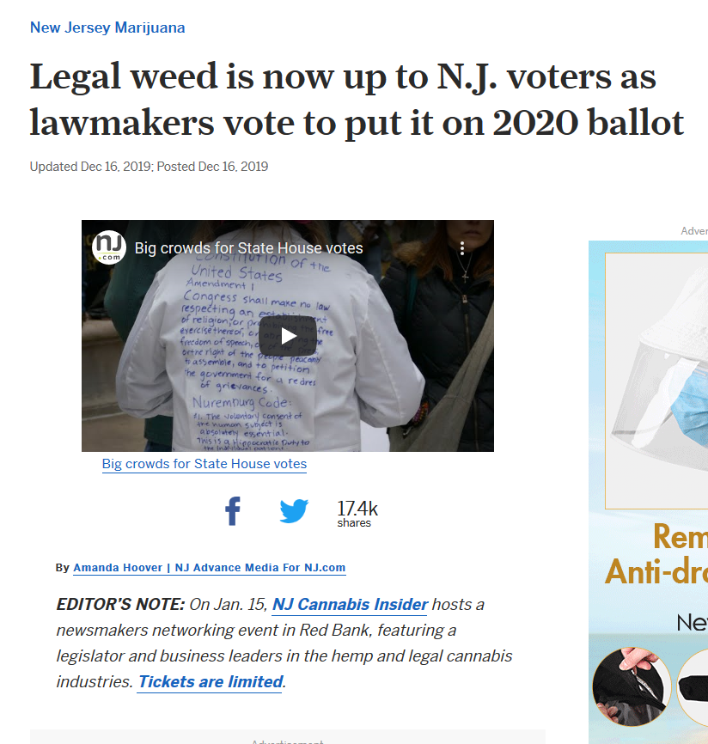
Marijuana: A Hot Topic in NJ
“Although I remain disappointed in the Legislature’s inability to legislatively legalize adult-use marijuana, I am optimistic that the people of New Jersey, who overwhelmingly support legalization, will vote to do so. And, when they do, we will take a critical and long overdue step for real criminal justice reform.”
Gov. Phil Murphy made legalizing marijuana for those over 21 one of his campaign promises. In the nearly two years since he took office, the initiative has seen several setbacks. State Senate President Stephen Sweeney announced in late November he would not take the bill to the floor, and would instead seek to put it to the ballot for voters to decide.
Sources: Hoover, A. (2019, Dec 6). Legal weed is now up to N.J. voters as lawmakers vote to put it on 2020 ballot. NJ.com. Retrieved April 10, 2020 from https://www.nj.com/marijuana/2019/12/voters-could-decide-if-nj-will-legalize-weed-after-senate-votes-to-put-it-on-2020-ballot.html
The State of New Jersey. (2019, Nov 26). Statement by Governor Murphy on Marijuana Decriminalization. Official Site of the State of New Jersey. Retrieved April 10, 2020 from https://www.nj.gov/governor/news/news/562019/approved/20191126b.shtml

Slide 11
How does our project relate to our education?
Although the four of us come from a variety of majors and interests, we were all drawn to this topic because of its prominence in the national, state, and local news. As public health majors, Alex and Celine were interested in the social structures at play in America. Incarceration, addiction, and disparities each highlight topics often discussed in our public health classes. As BAIT and math majors, Anna and Rachel were interested in the data science behind these issues. Moreover, as young adults at a majority liberal university in a ‘blue’ state, marijuana legalization is a focal point in many politicians’ platforms. From the case built in the previous slides, it is clear to see that there is a problem with incarceration in the U.S., and especially incarceration due to drug arrests. We see the inequities, and we hope to promote awareness of the issue and to investigate it further through our project.

Slide 12
Overview of Chosen Statistical Topic
We chose model selection for our project because we wanted to see which variables in our dataset modeled, or predicted, our outcome best, and which variables created the best fit. Cross-validation will help us to assess the accuracy and validity of our model; it will help us decide which model fits our data best in comparison to the other models + will help us avoid over-fitting.
The principle of parsimony suggests that the model with the least variables but with the greatest explanatory power is the most useful.
Additionally, in terms of real-world application, and experimenter preference, having less variables in your model can save time, money, and resources.

Slide 13
Dataset Description
CHOSEN DATASET: Arrests for Marijuana Possession
Data on police treatment of individuals arrested in Toronto (Canada) for simple possession of small quantities of marijuana
From the carData package in R
Sample size: n = 5,226 observations
8 variables total
dependent variable in ORANGE, independent variables in BLUE
Source: Friendly, M. (n.d.). Arrests for Marijuana Possession. [Dataset]. York University. http://math.furman.edu/~dcs/courses/math47/R/library/effects/html/Arrests.html

Slide 14
Variables in the Dataset
VARIABLE NAME | VARIABLE DESCRIPTION
released | Whether or not the arrestee was released with a summons; a factor with levels (yes, no)
color | The arrestee’s race; a factor with levels (black, white)
year | 1997 through 2002; a numeric vector
age | In years; a numeric vector
sex | A factor with levels (female, male)
employed | A factor with levels (yes, no)
citizen | A factor with levels (yes, no)
checks | Number of police databases (of previous arrests, previous convictions, parole status, etc. --- 6 in all) on which the arrestee’s name appeared; numeric vector
Source: Friendly, M. (n.d.). Arrests for Marijuana Possession. [Dataset]. York University. http://math.furman.edu/~dcs/courses/math47/R/library/effects/html/Arrests.html

Slide 15
Variables of Interest
From this data, we chose “released” as our dependent variable, and used the rest of the the variables as our potential predictors, or independent variables (i.e. colour, year, age, sex, employed, citizen, and checks).
For our project, we were interested in determining which characteristics (IVs) best predicted the release (DV) of an individual arrested in Toronto (Canada) for simple possession of small quantities of marijuana. Although our chosen dataset is not from the U.S., we thought it could help raise awareness about problems with incarceration worldwide.

Slide 16
3.
Materials + Methods
All about the code

Slide 17
Model Selection Explained
Forward step-wise selection
This process selects ONE variable at at time to be added to the model
As long as the p-value of the parameter is less than 0.30, the parameter gets included in the model
Backward step-wise selection
This process begins with all the parameters in the model and removes ONE parameter at a time
Parameters with p-values greater than 0.3 are removed until there are no candidates with a p-value above 0.3
Bi-directional step-wise selection
This process removes and adds parameters at the same time with the above p-value specifications

Slide 18
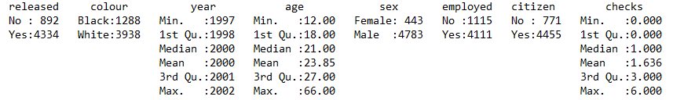
Step 1: Loading Dataset Into R
> #Looking at the "Arrests for Marijuana Possession" dataset using R
> library(carData) #Companion to Applied Regression Data Sets
> library(epiDisplay)#to use the function logistic.display for an easier view of the logistic model
> library(StepReg)#package for model selection of a logistic regression model
> summary(Arrests) #summary of the "Arrests for Marijuana Possession" dataset
> #There are 5226 observations with 8 variables
> data(Arrests, package="carData") #loads the specified data set
Source: (J. Mardekian, personal communication, April 9 , 2020)
Notes:
*split up training and testing - 50% split?

Slide 19
Step 2: Modeling the Relationship Between Response + Predictors
> #We are trying to find a model that tells us the relationship of if someone who was arrested for marijuana possession was released with a summons and specific factors of the arrestee.
> #We use a logistic regression since our dependent variable is binary categorical (Yes or No). Below is our complete model:
> logmodel <- glm(released~ colour+ year + age + sex + employed + citizen + checks, data = Arrests, family = "binomial").
Source: (J. Mardekian, personal communication, April 9 , 2020)

Slide 20
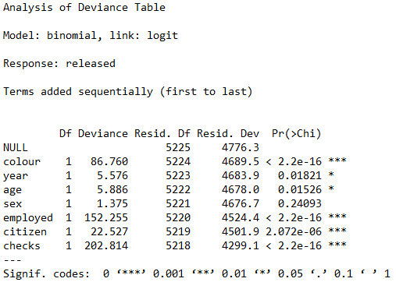
Step 3: Evaluate Our Complete Model
> anova(logmodel, test="Chisq")
> #By this point, we already have an idea that the most significant variables to y are checks, colour, employed, and citizen, but we want to still want to see what models we will get if we do the different types of selection.
Source: (J. Mardekian, personal communication, April 9 , 2020)

Slide 21
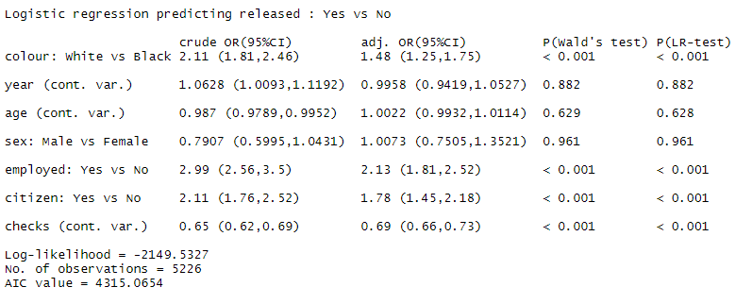
Step 4: Better Understanding Of Our Model
>logistic.display(logmodel)
> #obtain the percentage change in odds (pi/(1-pi)) for every
> #1-unit increase in Xi, holding all other X's fixed
> (exp(coef(logmodel)) - 1) * 100 #calculates odds ratio

Slide 22
Step 5: Can We Reduce The Amount of Independent Variables To Reduce Chance Of Overfitting?
> #We want to know if we need to include all independent variables of the dataset in this model.
> #Fewer variables means less variance and less variance means less chance of overfitting.
> #We will use model selection to find which independent variables are significant in predicting the dependent variable.
> #Generate stepwise selection procedures on the 7 predictors provided in the logmod statement.

Slide 23
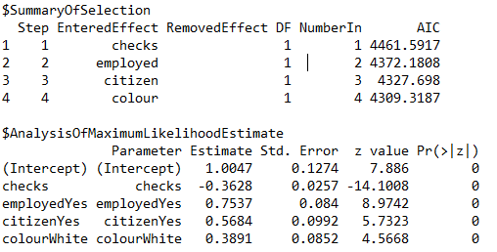
Step 6: Forward Selection
> stepwiselogit(data=Arrests,y, exclude = NULL, include = NULL, selection = "forward",
+ select = "AIC", sle = 0.15, sls = 0.15)
Source: (J. Mardekian, personal communication, April 9 , 2020)

Slide 24
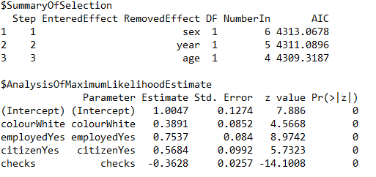
Step 7: Backward Elimination
> stepwiselogit(data=Arrests,y, exclude = NULL, include = NULL, selection = "backward",
+ select = "AIC", sle = 0.15, sls = 0.15)
Source: (J. Mardekian, personal communication, April 9 , 2020)

Slide 25
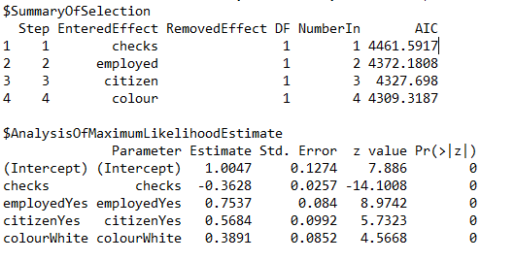
Step 8: Bidirectional Selection
> stepwiselogit(data=Arrests,y, exclude = NULL, include = NULL, selection = "bidirection",
+ select = "AIC", sle = 0.15, sls = 0.15)
Source: (J. Mardekian, personal communication, April 9 , 2020)

Slide 26
Step 9: K- Fold Cross Validation To Choose The Model With The Most Accuracy
> #We found that no matter what model selection technique we did, there are the same 4 significant independent variables for fitting our dependent variable and the model is the same model for each. Note that the lower AIC, the better!
> #But we need to know if there is still a better model where we can avoid overfitting.
> #Only looking at the AIC to determine which model you would choose is generally not enough in making sure you selected the best model.
> #We need to assess the accuracy and validity of each model to determine which model we should choose by Cross Validation or CV.
> #The technique we will use for CV is K-Fold Cross Validation because it has the advantage of using all data for estimating the model over other CV techniques.
> #We will go with a 10-Fold Cross Validation as k=10 is very common in applied machine learning and can yield test error estimates that do not suffer from high bias or variance. k=10 is also recommended if you are ever struggling with choosing a k.

Slide 27
Step 10: Comparing Our Model We Got From Model Selection Techniques With A Model With the 3 Most Significant Variables
> #Since we already know that no matter what selection technique we do, we get the same model, we can try to compare the model we got with a model that has the 3 most significant independent variables.
forward <- glm(released ~ checks + employed + citizen + colour, data=Arrests, family = "binomial")
> #looking at the forward selection output and finding the three most significant variables.
> forward2 <- glm(released ~ checks + employed + citizen, data=Arrests, family = "binomial")
Source: (J. Mardekian, personal communication, April 9 , 2020)
Source: (J. MaSource: (J. Mardekian, personal communication, April 9 , 2020)
rdekian, personal communication, April 9 , 2020)
Notes:
Since all models yielded the same variables, we chose forward selection because the first three variables that enter the model are the most significant.

Slide 28
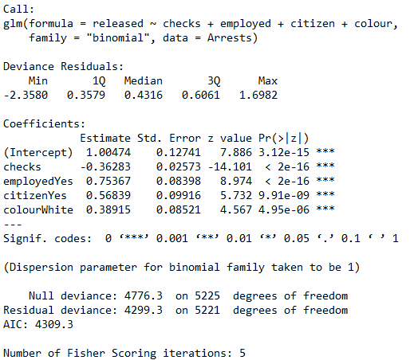
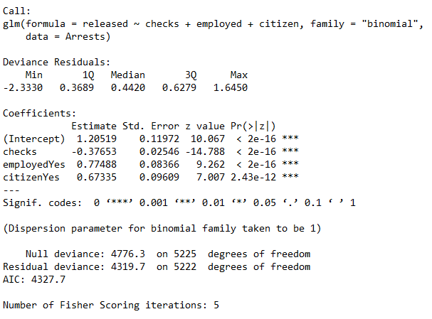
Step 11: Comparing Our Models
> summary(forward)
> summary(forward2)
># Even though the model “forward” had the lower AIC, just looking at AIC is not enough because this does not tell you if this model generally works if you applied it to data outside of your training data. This is why we still need to do Cross Validation.

Slide 29
Step 12: Start The CV To Choose The Model Between “Forward” and “Forward2”
> require(caret) #package used for cross validation
> library(e1071)
> # Define training control
> set.seed(13245)
> train.control <- trainControl(method = "cv", number = 10)
> # Train the model forward (4 predictors)
> model_forward <- train(released ~checks + employed + citizen + colour,data = Arrests, method = "glm",
+ trControl = train.control)
> # Define training control
> set.seed(14235)
> train.control <- trainControl(method = "cv", number = 10)
> # Train the model forward2 (3 predictors)
> model_forward2 <- train(released ~ checks + employed + citizen,data = Arrests, method = "glm",
+ trControl = train.control)
Source: (J. Mardekian, personal communication, April 9 , 2020)
Notes:
Cross validation= CV

Slide 30
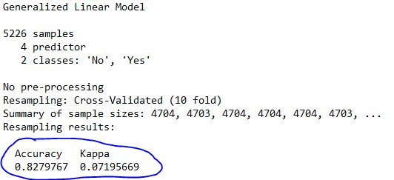
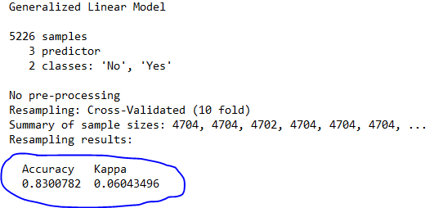
Step 13: Cross Validating
> # Summarize the results
> print(model_forward)
> # Summarize the results
> print(model_forward2)
>#Our kappa is low in both models due to the large sample size of our original dataset. So just looking at accuracy, we found the accuracy of the model forward2 (3 predictors) was greater.
># Hence we may have found a better model!
Source: (J. Mardekian, personal communication, April 9 , 2020)

Slide 31
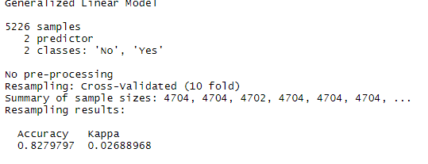
Step 14: Is Our Model With Three IVs Still Overfitting?
> #We kept the two most significant variables from forward selection, to check and see if we could get an even better model.
> # Define training control
> set.seed(14235)
> train.control <- trainControl(method = "cv", number = 10)
> # Train the model
> model_forward3 <- train(released ~ checks + employed,data = Arrests, method = "glm",
+ trControl = train.control)
> # Summarize the results
> print(model_forward3)
># This model (2 IVS) is less accurate than with 3 IVs, therefore the 3 IV model still seems like a better choice.
Notes:
IV = independent variables

Slide 32
Step 15: We Still Need More Information To Validate Forward2 (3 IVs), The Model We Choose
> #Assessing the predictive ability of the model we choose, forward2
> #Looking at the ROC Curve
> library(pROC)
> #generate ROC curve
> ROCresult <- roc(Arrests$released ~ forward2$fitted)
Setting levels: control = No, case = Yes
Setting direction: controls < cases
> plot(ROCresult, legacy.axes = TRUE)
> names(ROCresult)
> ROCresult$auc
># An AUC score of ~0.72 is considered acceptable which is good for our case

Slide 33
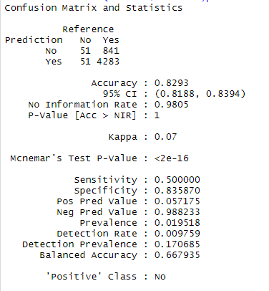
Step 16: Looking at the Confusion Matrix
# We would like to see how the model forward2 is doing as a classifier
#This analysis is provided for supplementary purposes only
predicted.released <- predict(forward2,data=Arrests,type='response') #using the type='response' option generates P(released|at each level of the predictors)
predicted.released <- ifelse(predicted.released > 0.5,"Yes","No") #predicted.released is 1 if predicted P(released|checks+employed+citizen) > 0.50, 0 otherwise
predicted.released <- as.factor(predicted.released) #need to be sure this variable is a factor
Arrests$released <- as.factor(Arrests$released) #need to be sure this variable is a factor
confusionMatrix(Arrests$released,predicted.released) #found in the caret library

Slide 34
4.
Results
Model Selection & K-Fold Cross-Validation

Slide 35
Forward
Backward
Bi-directional
MODEL SELECTION CONTINUED
Included parameters: checks, employed, citizen, color
AIC:
Excluded parameters: sex, year, age
AIC:
Included parameters: checks, employed, citizen, color
AIC:
Sex (6) Year (5) Age (4) | 4313. 0678 4311. 0896 4309. 3187
Checks (1) Employed (2) Citizen (3) Color (4) | 4461. 5 4372. 1808 4327. 698.5917 4309. 3187
Checks (1) Employed (2) Citizen (3) Color (4) | 4461. 5917 4372. 1808 4327. 698 4309. 3187
AIC (“Akaike’s Information Criterion”) is a common model selection criteria which is used to measure model performance. AIC is calculated by obtaining the maximum value of the likelihood function for the model. AIC suggests adding more parameters to a model will improve the goodness of fit, but will also increase the penalty imposed by adding more predictors. In logistic regression, AIC is especially useful since it is calculated using the model’s maximum likelihood estimator as a measure of fit.
Notes:
This slide compares all of the different model selection procedures.
All model selection procedures showed the same AIC value, which indicates any model selection procedure will yield the same predictors (checks, employed, citizen, color).
The lower the AIC indicates a better goodness of fit for the model.
Numbers next to predictors are the order in which they entered the model.

Slide 36
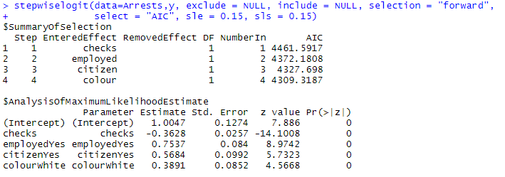
Output (Forward Selection)
Source: (J. Mardekian, personal communication, April 9 , 2020)

Slide 37
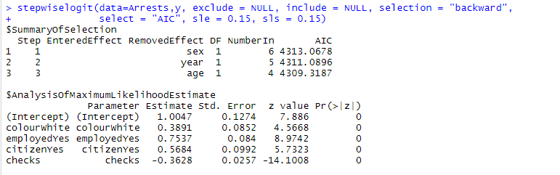
Output (Backward Selection)
Source: (J. Mardekian, personal communication, April 9 , 2020)

Slide 38
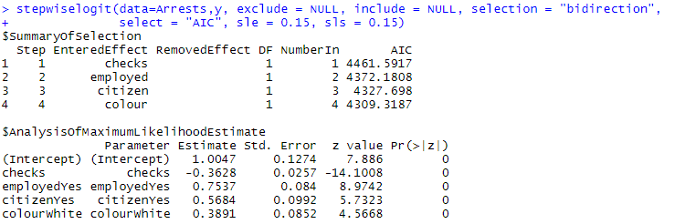
Output (Bidirectional Selection)
Source: (J. Mardekian, personal communication, April 9 , 2020)

Slide 39
Forward Selection Model
Included parameters | color, employed, citizen, and checks
Excluded Parameters | year, age, sex
Dependent Variable | Released (yes or no)
AIC | 4309.3187
P-Wald’s Test/P(LR-Test) | <0.001
Log Likelihood | -2149.6593
Beta Parameters | Intercept: 2.7312059, checks: 0.6957053, employed(Yes): 2.1247859, citizen (Yes): 1.7654211, color(white): 1.4757192
Percentage Change in Odds | Intercept: 173.12059, checks: -30.42947, employed(Yes): 112.47859, citizen(Yes): 76.54211, color(white): 47.57192
Notes:
This is a summary of the results of the forward selection model which we utilized to interpret the results; even though all model selection procedures yielded the same results, we chose forward selection since it shows that the first 4 variables to enter the model were the most significant.
In order to verify the accuracy of our model and avoid overfitting, we did not select this model as our final model, and proceeded to use cross validation to find the best model to predict our dependent variable (released).
Our 4-variable forward selection model revealed that the most significant variables for determining whether an individual would be released with a court summons were color (i.e. race of individual), employed (i.e. employment status), citizen (i.e. whether the individual is a legal citizen) and checks (i.e. previous police or arrest records).
Our AIC is about 4309.3187, which is a measure of the goodness of fit of the 4-variable forward selection model. Generally, the goodness of fit of a model increases as parameters are added to the model, but it also increases the penalty term (Pham, “New Criterion for Model Selection”, 2019).
The P-Wald’s Test and Likelihood Test contribute similar information in this example; the results of both tests show which variables contribute explanatory power to the dependent variable (or maximize the value of the likelihood function). In this example, we see that the values of both tests are <0.05, which indicates which variables are significant.
The log likelihood function is maximized to help find the coefficients of the logistic regression model.
The beta coefficients in the 4-variable forward selection model indicate for every 1 unit increase in X the log-odds (the natural logarithm of the probability of success/probability of failure), will change by the coefficients indicated above; these coefficients are useful indicators of how the model will behave when the number of individuals with certain characteristics (i.e. race, employed, citizen, and checks), increase or decrease.
The odds ratio is calculated through the formula (e^Bi), and the percentage change in the odds for every 1-unit increase of X (e^bi-1) is shown above; the percentage change in odds is a useful tool for understanding how the odds ratio per parameter changes as the number of individuals arrested changes, which ultimately impacts our dependent variable.
Source: https://online.stat.psu.edu/stat800/node/84/
Also included in results of our 4 variable forward selection model:
Deviance = measure of goodness of fit of a generalized linear model; higher numbers indicate a worse fit.
Null deviance: how well the response variable is predicted by a model that includes only the intercept; lower values are better.
Residual Deviance: how well the response variable is predicted by the model when predictors are included; higher numbers indicate bad fit; used to determine if H0 is true or not.

Slide 40
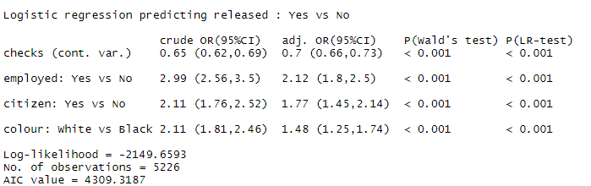
Forward Model Output Summary I
Source: (J. Mardekian, personal communication, April 9 , 2020)
Notes:
Logistic regression output of 4 variable forward selection model

Slide 41

Forward Model Output Summary II
Source: (J. Mardekian, personal communication, April 9 , 2020)
Notes:
forward in this example is the following model: forward <- glm(released ~ checks + employed + citizen + colour, data=Arrests, family = "binomial"), where released is the dependent variable, and checks, employed, citizen and color are independent variables.

Slide 42
4 Predictors
3 Predictors
2 Predictors
K-Fold Cross-Validation
Our data was broken into 10 buckets, with approximately 500 observations in each bucket
Included parameters: checks, employed, citizen, color
AIC: 4309.3
Accuracy: 0.8279767
Kappa: 0.07195669
Included parameters: checks, employed, citizen
AIC: 4327.7
Accuracy: 0.8300782
Kappa: 0.06043496
Included parameters: checks, employed
AIC: 4372.2
Accuracy: 0.8279797
Kappa: 0.02688968
Notes:
Sometimes modeling techniques can overfit the data (i.e. predictors may contribute redundant/unnecessary information to the model), which can result in cases where the model will poorly predict out-of-sample cases.
Cross validation is used to assess the accuracy and validity of the model by separating a dataset into testing and training data. Training data is used to build a model, which will predict values in the testing dataset.
In this example, our cross validation results revealed that the model with the highest accuracy (~0.83) is the model with 3 predictors (checks, employed, citizen).
K-Fold validation is a useful cross-validation technique as it uses all of the data to estimate the model, and can be used to evaluate models with higher predictive and explanatory power.
Accuracy: identifies the percentage of times the model correctly classified instances out of all possible outcomes (i.e. does it correctly classify the dependent variable based on the combination of independent variables).
Kappa: serves as a measure of agreement.

Slide 43
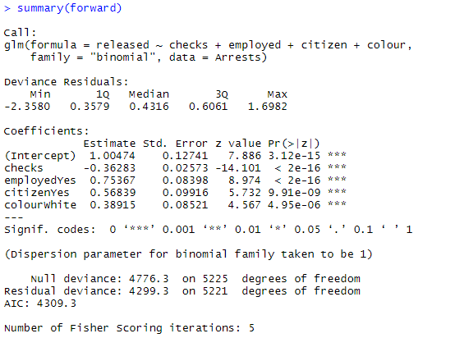
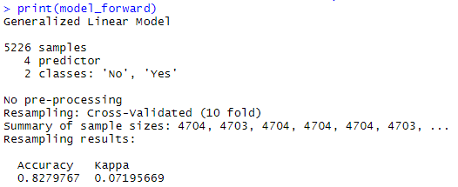
Cross Validation Output (4 Predictors)
Source: (J. Mardekian, personal communication, April 9 , 2020)

Slide 44
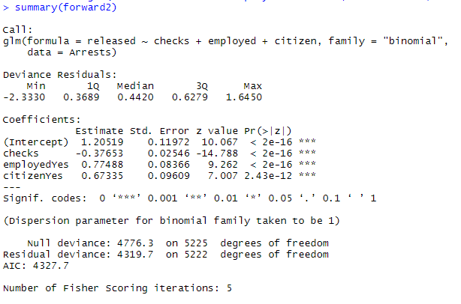
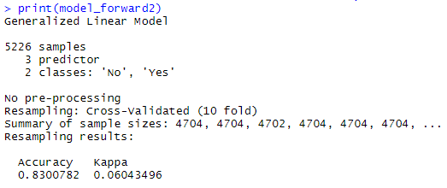
Cross Validation Output (3 Predictors)
Source: (J. Mardekian, personal communication, April 9 , 2020)

Slide 45
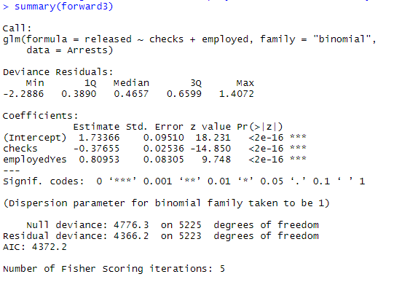
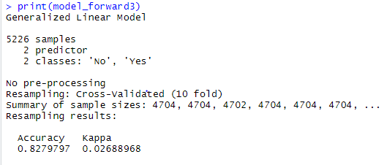
Cross Validation Output (2 Predictors)
Source: (J. Mardekian, personal communication, April 9 , 2020)

Slide 46
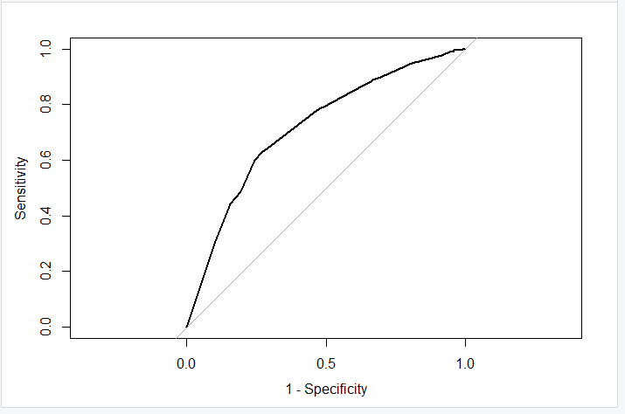

ROC Curve Results
An Receiver Operating Characteristic (ROC) Curve in logistic regression can be a useful tool in evaluating the performance of a classification model. ROC curves are used to determine the best cutoff value to predict whether a new observation will be classified as a failure (0) or a success (1).
In our example, our classification cutoff is at 0.5, where probabilities greater than this value are classified as a success, and probabilities below this value are classified as a failure. Area under the curve (AUC) can be used to evaluate how well a model distinguishes between different classes of observations. In our example, we have an AUC of 0.7188.
Since the AUC of our model is fair (close to 1), we can infer that our model is adequate at distinguishing between those individuals who were released with a court summons, and those who were not.
This AUC acts as supplementary information to further our findings.

Slide 47
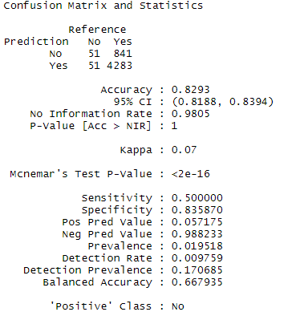
Confusion Matrix Results
In order to further assess the predictive ability of our logistic model, we used a confusion matrix, a useful tool for identifying where classification models can fall short when making predictions, and the types of errors that follow as a result.
In our example, we identify the decision boundary at 0.5. If the predicted probability of P(released|checks+employed+citizen) > 0.5 then predicted.released = 1, and 0 otherwise.
This confusion matrix reveals that our model has an accuracy rate of ~83%
However, the confusion matrix reveals that when our model predicted that an individual would not be released, only 51 individuals were actually not released, whereas 841 individuals were released. Similarly, when our model predicted that an individual would be released, only 4,283 individuals were actually released, whereas 51 were not.
The sensitivity rate was ~50% whereas the specificity rate was ~84%, revealing that our model struggled to accurately identify individuals who were released with a court summons.
Notes:
Confusion matrices are useful tools for summarizing the predictive ability of a model.
The sensitivity result in a confusion matrix represents the true positive rate (i.e. the ability of a model to correctly identify positive events).
The specificity result in a confusion matrix represents the true negative rate (i.e. the ability of a model to correctly identify negative events).

Slide 48
5.
Discussion
Chosen Model & Explanation of Chosen Model

Slide 49
Final Model Overview
CHOSEN MODEL: Forward 3-predictor model including checks, employed and citizen
EXPLANATION: Our model selection process yielded the same results between the forward, backward, and bi-directional models. However, cross-validation analysis showed that modeling with 3 variables (checks, employed, and citizen) was the most effective method as it resulted in a higher accuracy measure, without compromising the Kappa too much. This model also had an optimal AIC compared to the 2 predictor model. In addition, the results from the ROC curve showed a fair AUC value, which further supports the predictive ability of our model.
LIMITATIONS: Due to limited time of this project, we acknowledge that some of our methods could have been different if feasibility and timing were not at stake. In real world application, the data should have been split into testing and training datasets at the model selection stage prior to performing cross validation. We also could have cleaned the data prior to performing an analysis on it to filter out null responses. In addition, the confusion matrix revealed that our model accurately predicted individuals who would not be released with a court summons (who were not actually released) only 50% of the time. This issue could be attributed to the unbalanced sample (more individuals released than not) we performed our analysis on.
Notes:
We chose the forward model selection procedure to stay consistent with the procedure selected in our methods section.

Slide 50
6.
Works Cited

Slide 51
References
Drug Policy Alliance. (n.d.). Drug War Statistics. Retrieved April 10, 2020 from https://www.drugpolicy.org/issues/drug-war-statistics
Friendly, M. (n.d.). Arrests for Marijuana Possession. [Dataset]. York University. http://math.furman.edu/~dcs/courses/math47/R/library/effects/html/Arrests.html
Gramlich, J. (2020). Four-in-ten U.S. drug arrests in 2018 were for marijuana offenses - mostly possession. Pew Research Center. Retrieved March 31, 2020, from https://www.pewresearch.org/fact-tank/2020/01/22/four-in-ten-u-s-drug-arrests-in-2018-were-for-marijuana-offenses-mostly-possession/
Hoover, A. (2019, Dec 6). Legal weed is now up to N.J. voters as lawmakers vote to put it on 2020 ballot. NJ.com. Retrieved April 10, 2020 from https://www.nj.com/marijuana/2019/12/voters-could-decide-if-nj-will-legalize-weed-after-senate-votes-to-put-it-on-2020-ballot.html
Kelly, M. (2019, June 26). How many people are in prison on marijuana charges?. The Washington Post. Retrieved April, 10, 2020, from https://www.washingtonpost.com/politics/2019/live-updates/general-election/fact-checking-the-first-democratic-debate/how-many-people-are-in-prison-on-marijuana-charges/?arc404=true
PennState Eberly College of Science. (2018). 12.2 - Logistic Regression - Binary Response. STAT 800. Retrieved April 19, 2020 from https://online.stat.psu.edu/stat800/node/84/
The State of New Jersey. (2019, Nov 26). Statement by Governor Murphy on Marijuana Decriminalization. Official Site of the State of New Jersey. Retrieved April 10, 2020 from https://www.nj.gov/governor/news/news/562019/approved/20191126b.shtml
Wagner, P., Sakala, L., & Begley, J. (n.d.). States of Incarceration: The Global Context. Prison Policy Initiative. Retrieved April 10, 2020 from https://www.prisonpolicy.org/global/
(J. Mardekian, personal communication, April 9 , 2020)
Notes:
(E. Robbins, personal communication, January 4, 2001).
A. P. Smith also claimed that many of her students had difficulties with APA style (personal communication, November 3, 2002).
https://owl.purdue.edu/owl/research_and_citation/apa6_style/apa_formatting_and_style_guide/reference_list_other_non_print_sources.html

Slide 52
Thank You!

